Slide 1

STUDENT MANGMENT SYSTEM
By : Anas Aamer

Slide 2

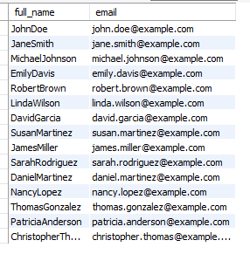
List all students with their full names and email addresses
Result

Slide 3
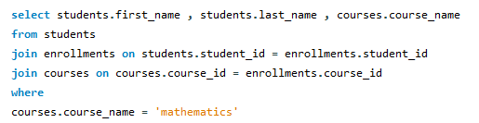

Retrieve the details of students who are enrolled in a course named Mathematics
Result

Slide 4

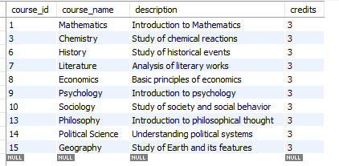
Find all courses with 3 credits
Result

Slide 5

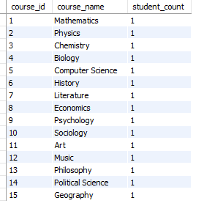
Get the total number of students enrolled in each course
Result

Slide 6

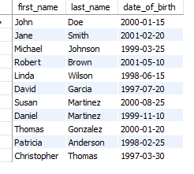
Get a list of all students with their birthdates who are older than 22 years
Result

Slide 7

Set the phone number of the student with student_id = 8 to 555-123-4567
Result

Slide 8
THANK YOU

